Slide 1
The Role of the Judiciary in “Interpreting” the Law: Significant Contributions the Judiciary has made to our Form of Government
Hon. Richard C. Tallman
United States Circuit Judge
Ninth Circuit Court of Appeals

Slide 2
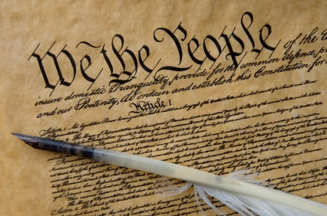
United States Constitution Article III, §1
“The judicial power of the United States, shall be vested in one Supreme Court, and in such inferior courts as the Congress may from time to time ordain and establish.”

Slide 3
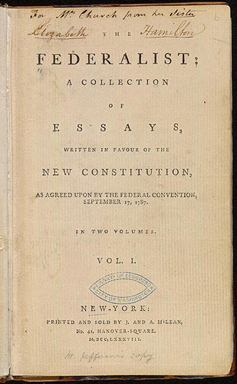
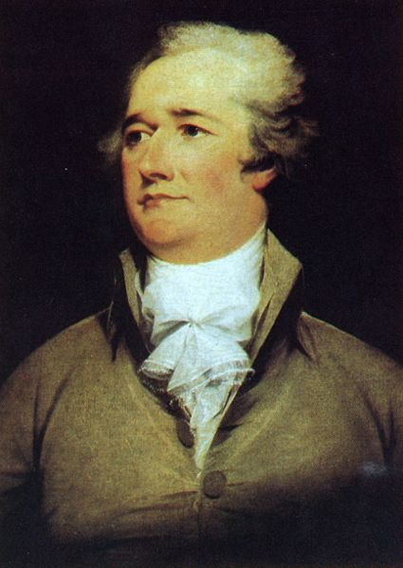
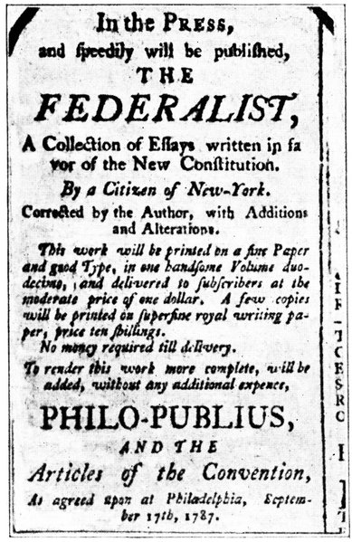
Alexander Hamilton

Slide 4
John Adams
William
Marbury
James
Madison

Slide 5
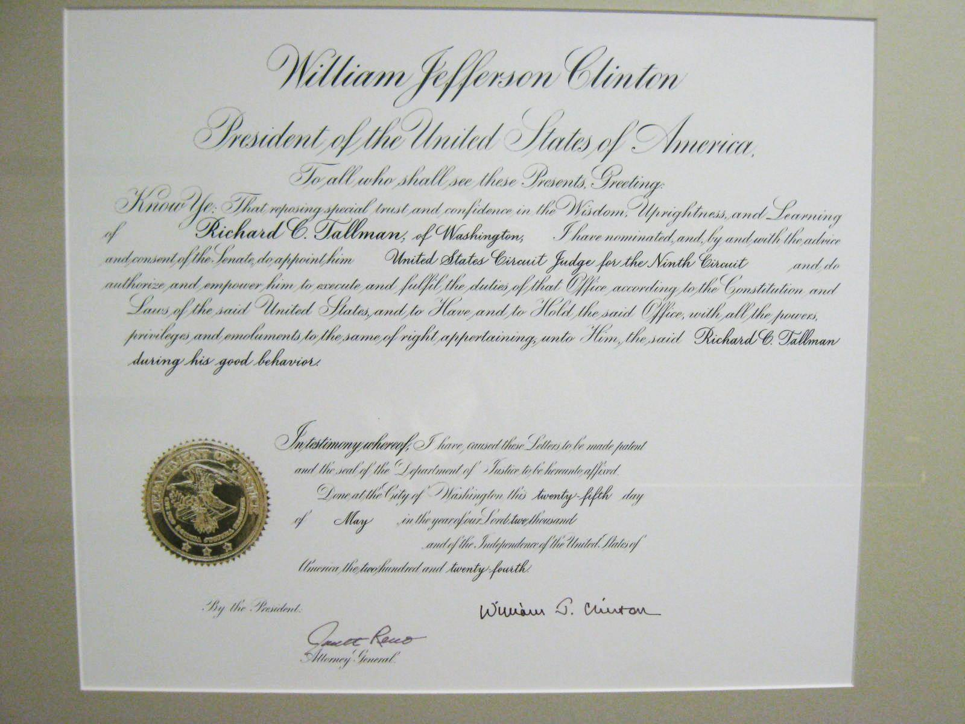

Slide 6
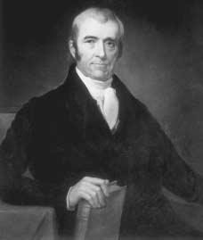
Chief Justice John Marshall
“It is, emphatically, the province and duty of the Judicial Department to say what the law is.”
Marbury v. Madison (1803)

Slide 7
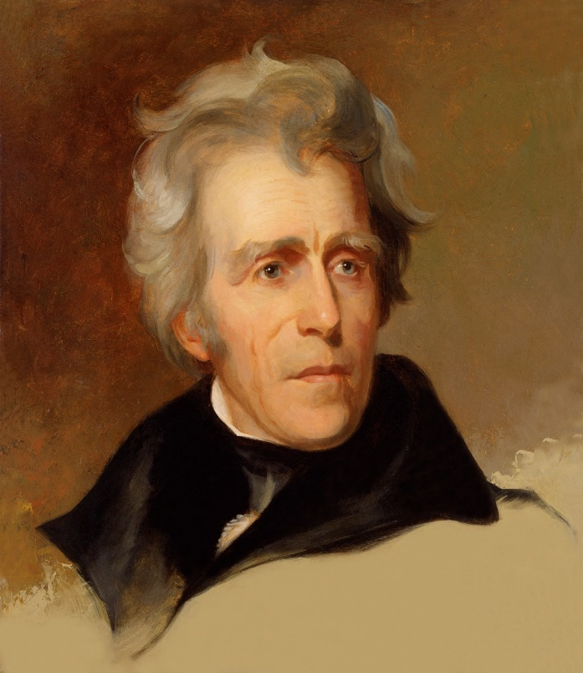
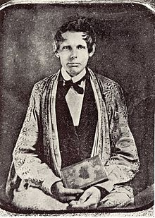
President Andrew Jackson
Worcester v. Georgia (1832)
“John Marshall has made his decision, now let him enforce it.”

Slide 8
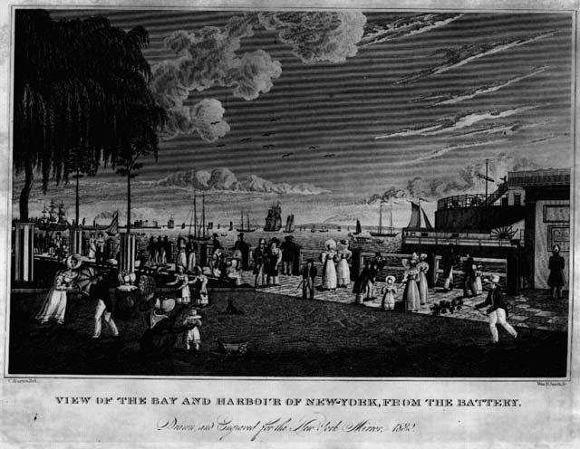
Gibbons v. Ogden

Slide 9
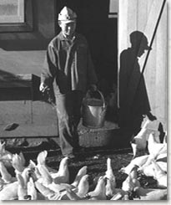
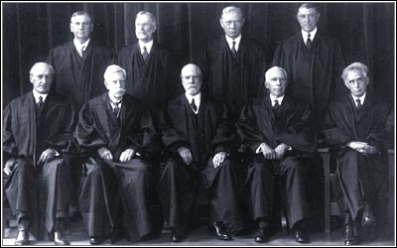
A.L.A. Schechter Poultry Corp. v. United States (1935)
United Press International -1935
The Schechter brothers victoriously lift lawyer Joseph Heller in the halls of the Supreme Court after the Hughes Court (right) struck down the government’s New Deal legislation.

Slide 10
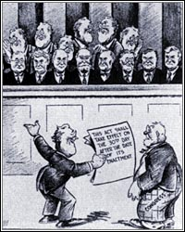
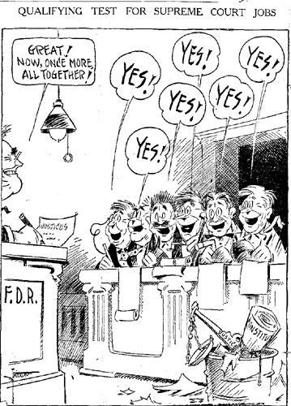
Court Packing Political Cartoons
“He’s down there all right! – It’s just a question of what bait he will go for!”
“This act shall take effect on the 30th day after the date of it’s enactment”
“Great! Now once more, all together!”
“A new recovery program”

Slide 11
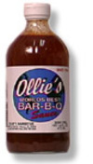
Katzenbach v. McClung (1964)
Heart of Atlanta Motel v. United States (1964)

Slide 12
United States v. Lopez (1993)

Slide 13
Katz v. United States (1967)
“The Government’s activities . . . violated the privacy upon which [Katz] justifiably relied while using the telephone booth and thus constituted a ‘search and seizure’ within the meaning of the Fourth Amendment.”
“Wherever a man may be, he is entitled to know that he will remain free from unreasonable searches and seizures”
– Justice Stewart

Slide 14
Terry v. Ohio (1968)

Slide 15
The Fifth and Sixth Amendment Rights
Miranda v. Arizona (1966)
Gideon v. Wainwright (1963)
Mug Shot of Ernest Miranda
The police officer who interrogated Miranda
Clarence Earl Gideon

Slide 16
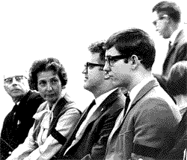
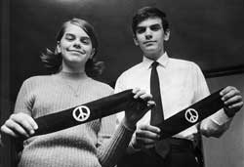
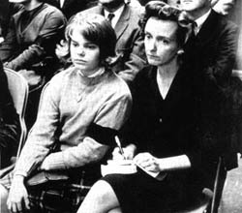
Tinker v. Des Moines Independent Community School District (1969)
“Freedom of expression would not truly exist if the right could be exercised only in an area that a benevolent government has provided as a safe haven for crackpots.” - Justice Fortas

Slide 17
Morse v. Frederick (2007)
Students holding “Bong HiTs 4 Jesus” sign during Olympic Torch relay
Demonstrators on the Supreme Court steps on the day Morse v. Frederick was argued
“The message on Frederick's banner is cryptic. It is no doubt offensive to some, perhaps amusing to others. To still others, it probably means nothing at all. . . . But Principal Morse thought the banner would be interpreted by those viewing it as promoting illegal drug use, and that interpretation is plainly a reasonable one.” - Chief Justice Roberts

Slide 18
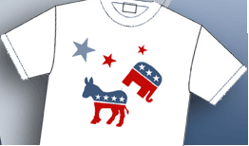
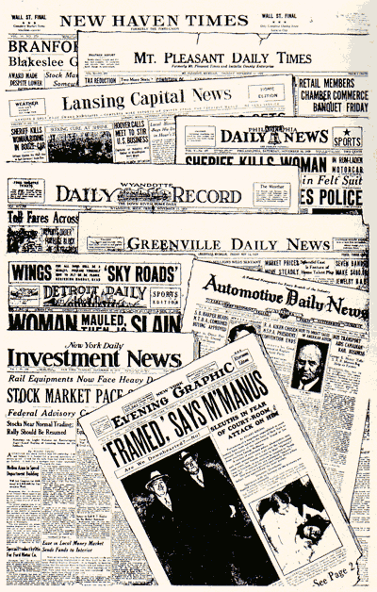
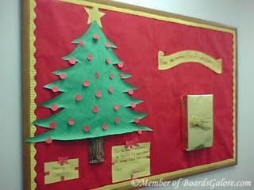

Slide 19
Fisher v. University of Texas (2016)
Abigail Fisher at the Supreme Court in 2012
Abigail Fisher at the Supreme Court in 2015
“Formalistic racial classifications may sometimes fail to capture diver­sity in all of its dimensions and, when used in a divisive manner, could undermine the educational benefits the University values. Through regular evaluation of data and consideration of student experience, the University
must tailor its approach in light of changing circumstances, ensuring that race plays no greater role than is necessary to meet its compelling interest.” - Justice Kennedy

Slide 20
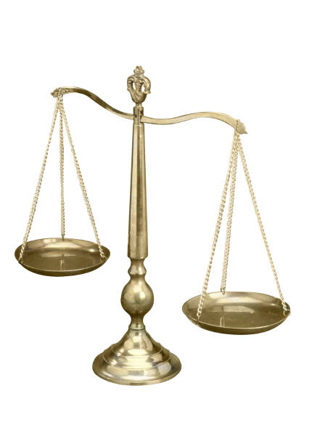
Judicial Independence, Accountability and Activism

Slide 21
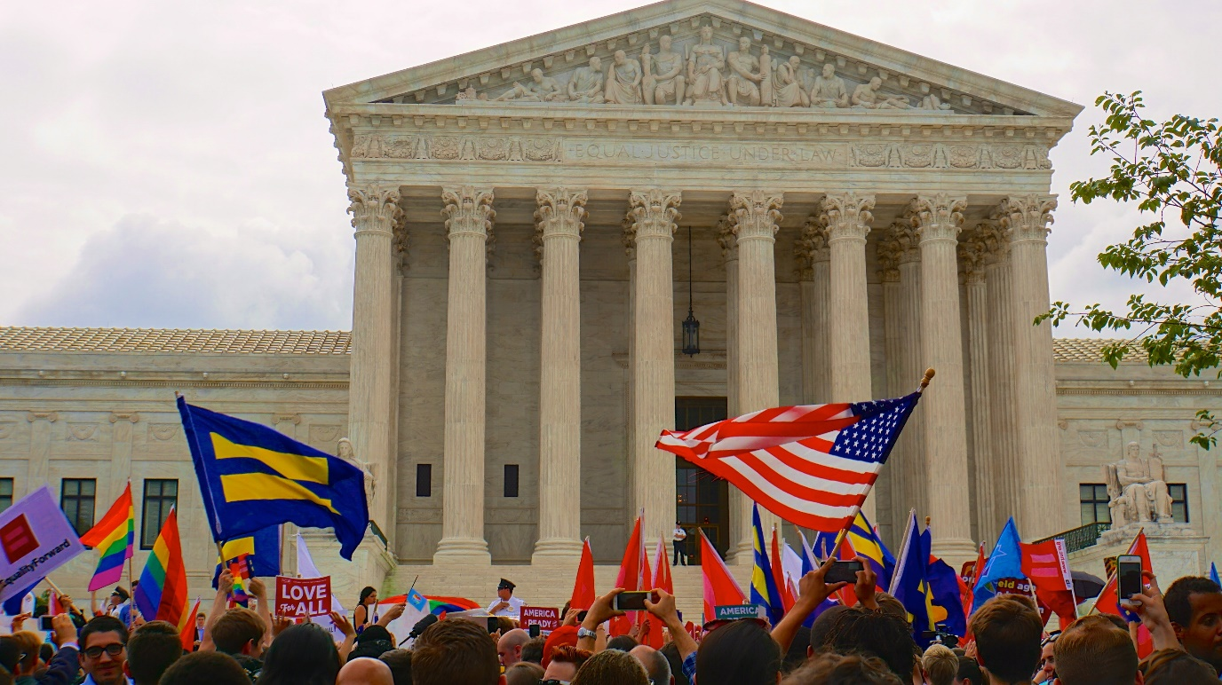
Obergefell v. Hodges (2015)
“These considerations lead to the conclusion that the right to marry is a fundamental right inherent in the liberty of the person, and under the Due Process and Equal Protection Clauses of the Fourteenth Amendment couples of the same-sex may not be deprived of that right and that liberty. The Court now holds that same-sex couples may exercise the fundamental right to marry. No longer may this liberty be denied to them.”
- Justice Kennedy

Slide 22
Hon. Richard C. Tallman
United States Circuit Judge
Ninth Circuit Court of Appeals
For more information about landmark Supreme Court cases visit the Supreme Court Historical Society website at:
www.supremecourthistory.org

