Slide 1

Notes:
Our Agency, which is part of DHS, makes decisions on applications for immigration benefits.
I am thrilled to be here to talk about requirements for various immigration benefits so you can get a better picture of how our immigration system works.
Better understanding our nation’s legal immigration system, helps everyone understand what immigrants go through and I hope will build some acceptance and tolerance, which is key in our multi-cultural society.
When people are in lawful immigration status, they will more likely feel a part of our civic society and contribute to it positively.
I though I’d start out with a few examples immigrants that have made contributions to our country.

Slide 2
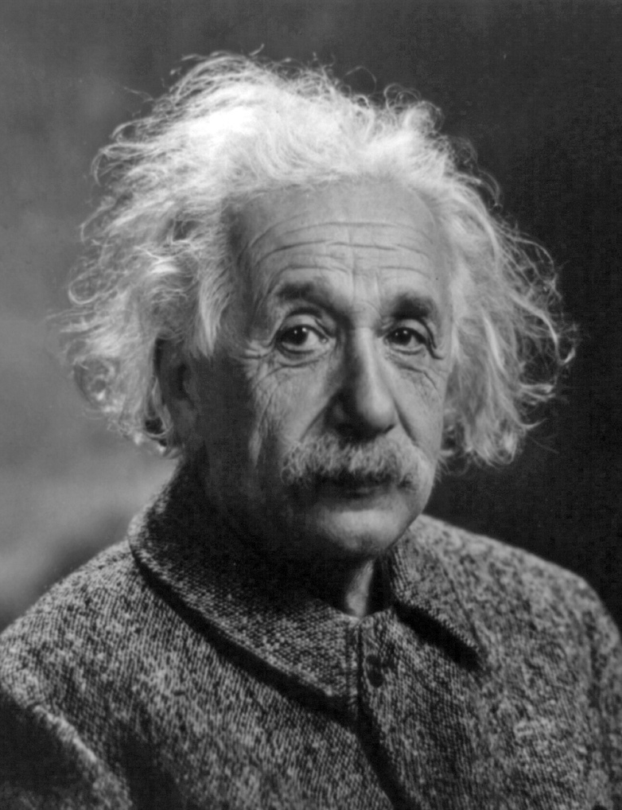
Who is this?
Albert Einstein
Physicist
Born in Germany
Naturalized US Citizen
Notes:
But first, we are going to start out with some famous immigrants – see if you know
Naturalized in 1940.

Slide 3

Who is this?
Stephan Frei
Seattle Sounders Goalie
Born in Switzerland
Naturalized USC 2017

Slide 4

Who is this?
Arnold Schwarzenegger
Former Governor of California; Actor
Born in Austria
Naturalized US Citizen
Notes:
Naturalized in 1983

Slide 5
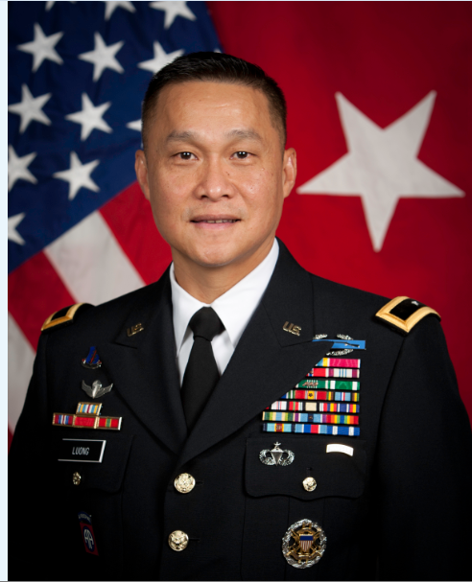
Who is this?
General Viet Luong
First Vietnamese-American General in U.S. Army
Born in Vietnam

Slide 6

Who is this?
Natalie Portman
Actress
Born in Israel
Derivative U.S. Citizen
Notes:
Her mother was a U.S. citizen at the time of her birth

Slide 7

Who is this?
Sergey Brin
Co-Founder of Google
Born in Russia
Derivative US Citizen

Slide 8
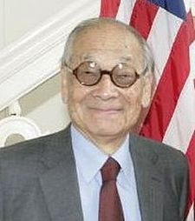
Who is this?
I.M. Pei
Architect
Born in China
Naturalized US Citizen
Notes:
Mr. Pei was born in China in 1917. Came to the U.S. to study architecture at MIT and Harvard. His designs include: The Grand Louvre, Paris; The Rock and Roll Hall of Fame, Cleveland; Gateway Towers, Singapore; The JFK Library, Boston. Naturalized in 1954.

Slide 9

Who is this?
Salma Hayek
Actress
Born in Mexico
Naturalized U.S. Citizen

Slide 10

Immigration 101

Slide 11
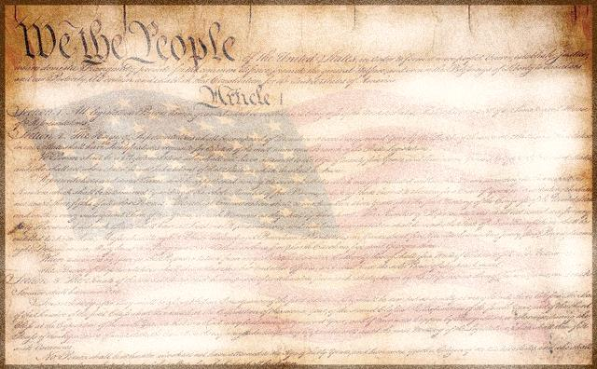








The US Government – The big picture
The US Constitution
Establishes the US as a nation of laws and defines the roles of government
Legislative Branch
Executive Branch
Judicial Branch
“Makes the Laws”
“Enforces the Laws”
“Interprets the Laws”
Determines constitutionality of Immigration Laws and their application and/or enforcement
Establishes Immigration Laws on behalf of the citizenry of the US
Executes and enforces the Immigration Laws passed by Congress
Notes:
Judicial Branch is our host today – and they determine the constitutionality of our immigration laws and our application of them. Keep us in line.

Slide 12
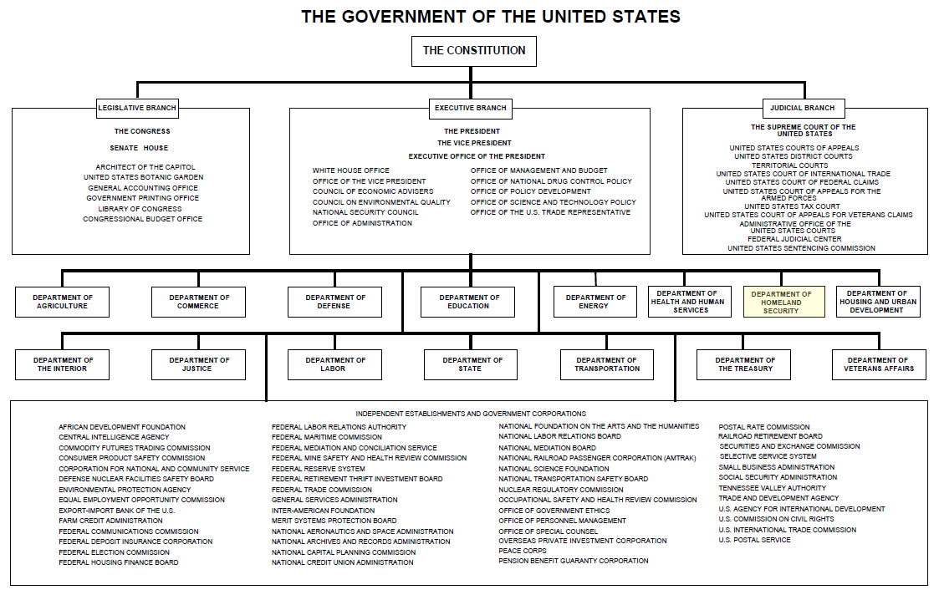
Notes:
DHS is Cabinet-level Department in the Executive Branch of the Federal Government
DOE is in the middle!!

Slide 13







Department of
Homeland Security
Est. 2002
Executive Branch
“Enforces the Laws”
DHS Goals:
-Prevent terrorism and enhance security
-Secure and manage our borders
-Safeguard and secure cyberspace
-Ensure resilience to disasters
-Enforce and administer our immigration laws
Department of Homeland Security
Cabinet-level department …like Defense, Treasury, State, Justice, etc.
Notes:
DHS established in 2002. Huge Department with many agencies to include – ICE CBP, FEMA, USCG, TSA - USCIS in 2003.
Our mission is to Enforce and administer our immigration laws

Slide 14

Department of Homeland Security
Secretary
------------------ Deputy Secretary
Transportation Security Administration
U.S. Customs & Border Protection (CBP)
U.S. Citizenship & Immigration Services (USCIS)
U.S. Immigration & Customs Enforcement (ICE)
U.S. Secret Service
Federal Emergency Management Agency
U.S. Coast Guard
Law Enforcement
Inspects travelers at ports of entry
Makes arrests
Deports people
Holds people in detention
Customer Service
Issues work permits and green cards
Interviews applicants for citizenship
No arrest authority
Law Enforcement
Investigates crimes
Makes arrests
Deports people
Holds people in detention
* highlighted boxes indicate immigration authority
Notes:
The organizational chart highlights the various DHS entities. I’ll talk about USCIS’ mission later but I want to distinguish us from ICE and CPB, the 2 other DHS entities who have an immigration mission.
Customs and Border Protection (CBP) has border enforcement authority. CBP officers have arrest authority, they carry guns and handcuffs. CBP has about 40,000 people assigned to airports, seaports and land border crossings who process legitimate travelers and cargo and attempt to detect unlawful travelers and cargo. CBP includes about 15,000 Border Patrol Agents who work in between the ports of entry to detect and deter unlawful entries.
Immigration and Customs Enforcement (ICE) handles interior enforcement away from the immediate border and detention and removal operations. There are about 20,000 ICE employees who oversee investigations, detention and removal, smuggling rings, counterfeit documents, etc. These agents also have arrest authority, they carry guns and handcuffs and they deport people from the United States.
U.S. Citizenship and Immigration Services (USCIS) is the only customer service agency in DHS. It is comprised of about 19,000 employees assigned to 223 offices in the United States and overseas.
USCIS employees do not have arrest authority, we do not carry guns or handcuffs and we do not deport people. We determine if applicants are eligible for benefits and guard for fraud and national security issues in the process.

Slide 15
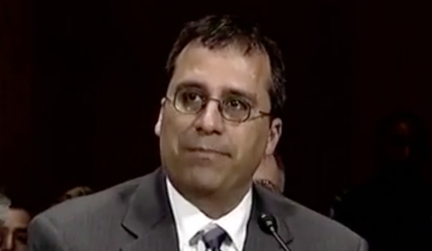

USCIS Mission
secure America’s promise as a nation of immigrants
provide accurate, useful information to customers
grant immigration benefits
promote an awareness of citizenship
ensure the integrity of our immigration system
USCIS Director
L. Francis Cissna
Notes:
Now, U.S. Citizenship and Immigration Services has a single mission focus, we handle immigration benefits only.
Put another way, we strive to “Give the right benefit to the right person in the right amount of time. And ensure that those who are not eligible do not receive the benefit.”
We do send people out to visit employers and people’s homes if we suspect fraud. But most applications are approved.
USCIS employees do not have arrest authority.

Slide 16

Immigration & Nationality Act
Complex
Personal
Powerful
Each amendment makes the law more complex
Notes:
Immigration legislation passed by Congress over the years provides the roadmap for “immigration agencies” in DHS. Anytime Congress legislates, the appropriate Executive Branch Department/Agency will take the legislation and they write further implementing regulations and policies to assist with implementation of the legislation.
The primary piece of immigration legislation is the: Immigration and Nationality Act of 1952, as amended. It has been amended many/many times since then and continues to evolve in a some what piecemeal way. There has been: Refugee Relief Act 1953; Quota system 1965; IRCA 1986 – perhaps the most major piece of legislation (made it illegal for employers to hire undocumented people, provided an Amnesty, and created the VW program which now 38 countries participate); Immigration Act 1990; Illegal Immigration Reform and Immigrant Responsibility Act 1996; Child Citizenship Act 2000; CSPA 2002;
On an average day:
We grant permanent residence (green cards) to 3,300 people
We welcome/naturalize 3,400 new citizens
We process 400 refugee applications and grant 40 people asylum status
We serve 12,000 customers at our 86 local offices and answer 41,000 calls to our toll-free customer service line
We complete 30,000 applications for various immigration benefits
We verify the employment eligibility of more than 80,000 new hires in the United States for employers

Slide 17
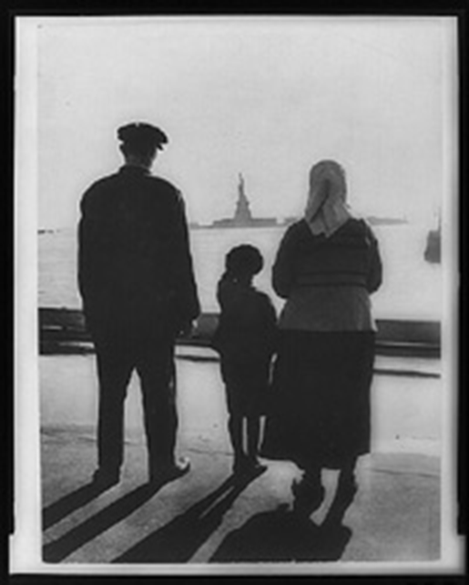
Why Immigrate to the U.S.?
Work
Join Family
Freedom
Opportunity
Notes:
First, was anyone here not born in the US? Raise your hand.
Does anyone else know anybody that was not born in the US? Raise your hand. Family members, friends?
Let’s look at some of the reasons why people come to the US. Can you name some reasons?
People come to work. They may come to join other family members. Some people come to the US because conditions in their country are so bad that they may fear persecution and they seek freedom. And some come for better educational opportunities and go to school in the US. Some win the lottery.

Slide 18

What is a Visa?
A visa allows someone to apply for admission to U.S.
A visa does not guarantee entry to U.S.
Visas can be cancelled
Visas are issued by the State Department
Notes:
Where do you get a visa and who issues one? Outside US and by DOS.
This word is often confused with other immigration terms.

Slide 19


Visa Categories
Immigrant visas are permanent
  Family-based
  Employment-based
Non-Immigrant visas are temporary
  Tourists
  Students
  Specialized workers
Notes:
There are two categories of visas—
Immigrant visas, when you plan to live permanently in the United States. Immigrant visas are given for two main reasons—relationship to a family member willing to sponsor you or relationship to an employer willing to sponsor you. I’ll go into this in more detail in a minute.
Non-Immigrant Visas--The other kind of visas are called non-immigrant visas, and they are for temporary visits to the U.S. for specified periods of time. Non-immigrant visas include foreign students, tourists, specialized workers/H1B’s-computer programmers/engineers, diplomats, journalists, professors, inter-company transferees, performers, athletes, and other special categories.

Slide 20
Immigrant Visas
Family-Based Visas
U.S. citizens can file for:
  Husband/wife
  Children of any age
  Parents
  Brother/sister
Permanent Residents can file for:
  Husband/wife
  Unmarried children of any age
Notes:
The US policy for immigrants has been largely based on two dominating philosophies – to promote family reunification and to facilitate the economy by facilitating skilled workers coming to the US
Thus there are two primary ways to emigrate to the United States—by family relationship or employment relationship.

Slide 21
Immigrant Visas
Employment-based visas
  Lengthy & complex
  Using an attorney is advisable
Humanitarian
  Refugee or asylee
  VAWA
  Victims of trafficking or other crimes
Notes:
The other way to get an immigrant visa is through an employer who wants to hire you.
Your employer will have to prove that you have skills that no other permanent resident or U.S. citizen in that job market has. This can be very time-consuming and labor intensive.
This is a complex process.
Also there are some humanitarian categories that are more specialized that allow the legal equivalent of an immigrant visa.
Explain GREEN CARD – Term often used. when someone comes into the US with an “IMMIGRANT VISA” or is eligible to adjust their status when they are in the US to the same status as someone who is outside the US and could get an immigrant visa, they get a Green Card.

Slide 22

Immediate Relatives of U.S. citizens
Immediate relatives of U.S. citizens are not subject to numerical limits set by Congress
Immediate relatives include:
  Husband/wife of USC
  Minor unmarried child of USC
  Parent of USC
Notes:
22
Family relationships are limited to immediate family. You cannot petition for an aunt or uncle or grandfather or grandmother. Certain Family-based visas are unlimited – those for immediate relatives such as spouses and unmarried children under 21 of US citizens.
Other immediate relative categories are very over-subscribed – particularly sisters and brothers and relatives of LPRs. There are many more applications than visas allowed by Congress.
Family petitions filed by permanent residents take much longer because there are quotas instituted by Congress for each family relationship and for each country. There are no quotas on visas available to immediate relatives of USCs. Therefore, if someone is a permanent resident and has filed for his/her family members, and they become USC, they need to immediately upgrade their relatives’ petitions. In most cases this will reduce the wait time.
ALSO HANDLE ADOPTIONS

Slide 23
Security Clearance
All applicants go through security checks
Security checks performed by different government agencies
Security checks must be complete before final decision

Slide 24
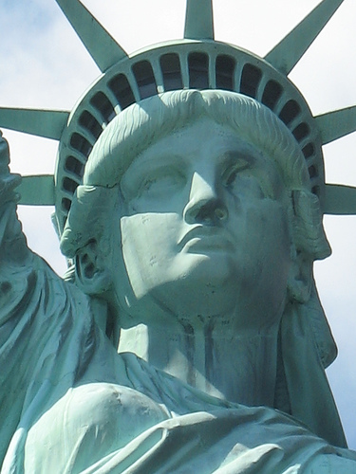
Naturalization 101

Slide 25

Why Naturalize?
Vote
U.S. Passport
Run for elected office
Work for U.S. Government
Upgrade family petitions
Serve on a jury
Notes:
What are some advantages of being a USC? Name some?
US citizens are not deportable
• Bringing family members to the U.S. - Citizens generally get priority when petitioning to bring family members permanently to this country.
• Obtaining citizenship for children born abroad. In most cases, a child born abroad to a U.S. citizen is automatically a U.S. citizen.
• Traveling with a U.S. passport. A U.S. passport allows you to get assistance from the U.S. government when overseas.
• Becoming eligible for federal jobs. Certain jobs with government agencies require U.S. citizenship.
• Becoming an elected official. Many elected offices in this country require U.S. citizenship.
• Showing your patriotism. Becoming a citizen is a way to demonstrate your commitment to your new country.

Slide 26

General Requirements
All naturalization applicants must:
be at least 18 years old
have lived in local jurisdiction for 3 months before applying
show willingness to support and defend U.S. Constitution
take the Oath of Allegiance
Notes:
Students who are 18 or older may apply for naturalization within their school’s jurisdiction or where their parents live
They must fill out a form.

Slide 27

Filing the Naturalization Application
Form N-400 and instructions available at: www.uscis.gov/forms
Study materials and practice tests available for free at: www.uscis.gov/citizenship
Notes:
Processing times – about 5-6 months, often less

Slide 28
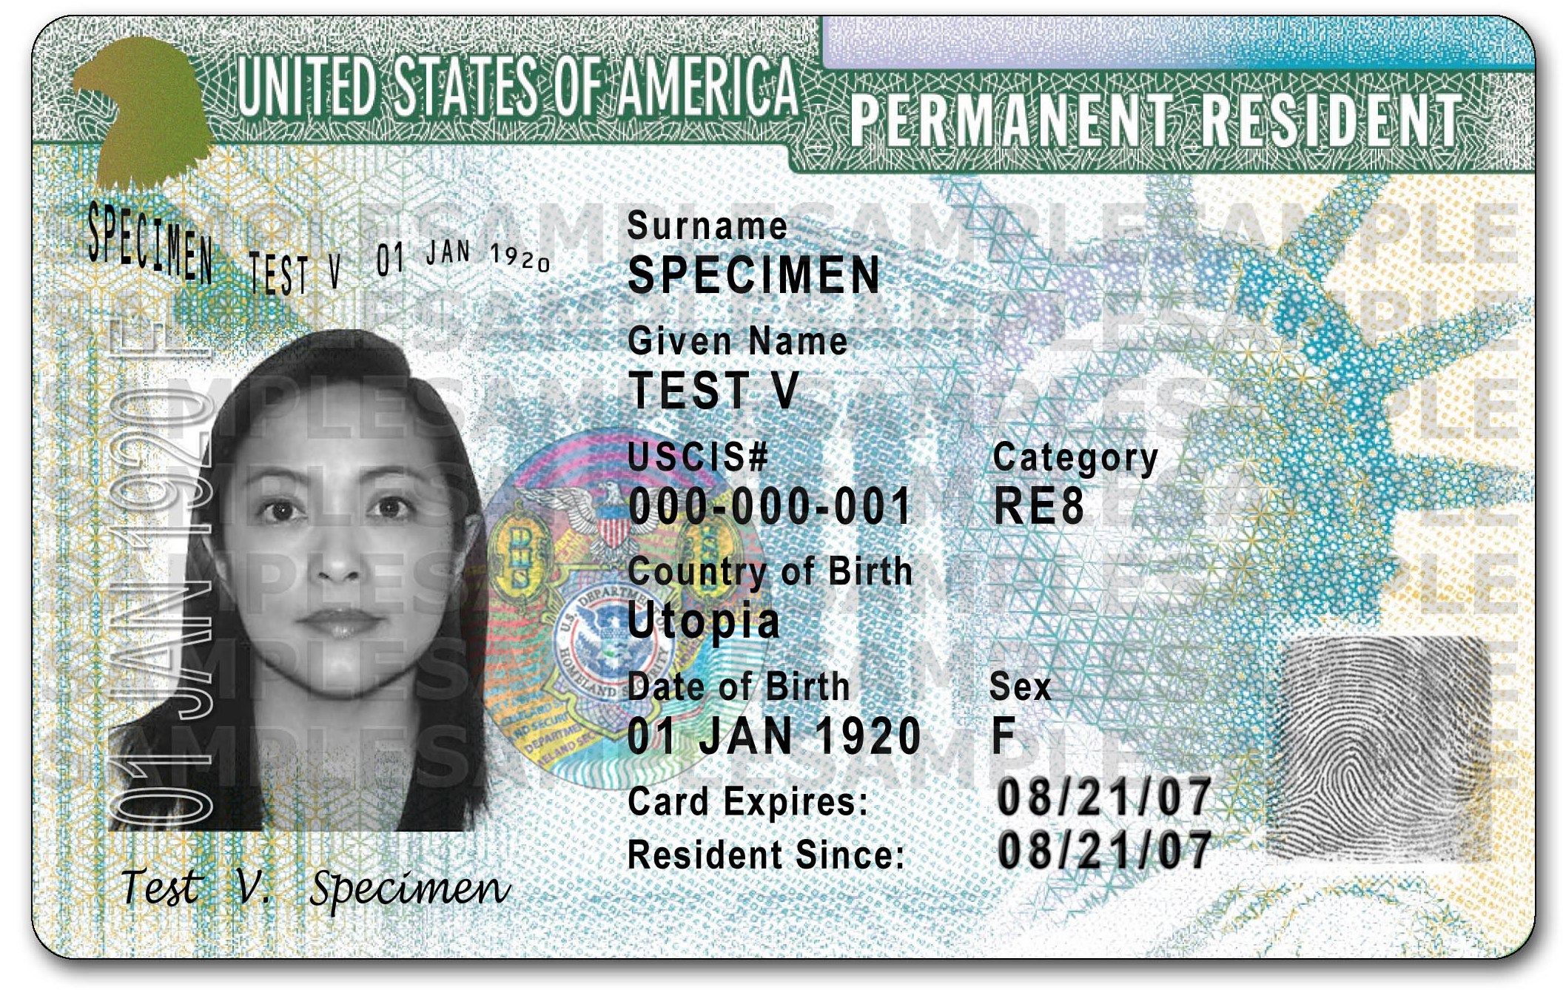
Time as a Permanent Resident
Naturalization applicants must be a permanent resident for:
3 years if married to a U.S. citizen
5 years for all other green card holders
Some exceptions apply for active duty military personnel
Notes:
The period of residency required (3 or 5 years) is referred to as the “statutory period”, because this time period is a requirement of law, not regulation.

Slide 29

Continuous Residence
Citizenship applicants must maintain a residence in the U.S. for a required period of time
Absences of 6 months to 1 year may “stop the clock” on continuous residence
Absences of 1 year stop the clock
Notes:
Residence – where do you live? Where are your personal belongings? Where is your family? It can be a shared home, a rented home, a group home.
We do accept applications from homeless people. However, the applicant needs to provide an address. This could be their case worker’s address, or a shelter address.

Slide 30

Physical Presence
“Physical presence” is the time applicant has been physically present in the U.S.
Physical presence is cumulative, trips outside U.S. count against “physical presence”
Applicants must spend HALF of statutory period physically in U.S.
Notes:
Applicants married to a U.S. citizen must have at least ___ days (half of 3 years) in the U.S. to qualify
All other applicants must have at least __ days (half of 5 years)
If married to a U.S. citizen, statutory period is 3 years
All others, statutory period is 5 years

Slide 31

Good Moral Character
Applicants must show good moral character during statutory period and up to Oath of Allegiance.
Committing certain crimes during statutory period shows a lack of good moral character.
Notes:
Good moral character is not the same as perfect character. Many offenses that people are worried about will not prevent them from naturalizing. Traffic tickets, parking tickets, minor offenses do not bar a person from naturalizing. Some crimes can make someone permanently ineligible for U.S. citizenship, such as murder or other serious felonies.
A parking ticket is a citation. This would not disqualify you, but not answering truthfully might. One reason we look at these types of citations is because while the ticket itself may not disqualify you, not paying the ticket or fulfilling other obligations, can disqualify you. You should be able to show that you have rehabilitated, or paid your debt to society.
Other items to consider: Are child support payments current? Do you owe taxes? If so, have you made a payment plan with the IRS? Are you required to register for the draft? Are you on probation or parole? Are you an addict? Have you sought treatment?

Slide 32

Knowledge of English and Civics
Applicants must… …understand, read, write, and speak basic English
…have knowledge of U.S. history and government
***Some applicants, because of age and time as a Permanent Resident, or because of a medical condition, have different English and civics requirements.

Slide 33
Exemptions from English Requirement
At the time of filing…
Applicant is
at least:
Lived as a permanent resident in U.S. for:
Applicant does not take the:
Applicant takes the:
50
20 years
English test
civics test in their language
55
15 years
English test
civics test in their language
65
20 years
English test
simplified civics test in their language
Notes:
Our regulations allow applicants to apply for naturalization 90 days before their 3rd or 5th anniversary of becoming a permanent resident.
One of the biggest issues we face now with our aging population is that people have difficulties learning English and the civics knowledge requirements.

Slide 34
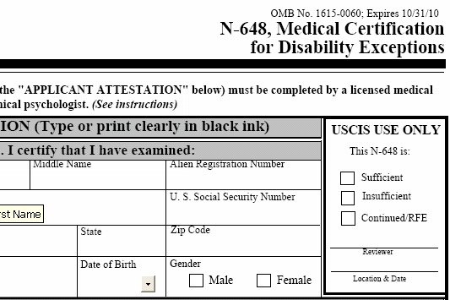
Disability Exceptions
Applicants with a medical condition that prevents them from learning may be waived the English & civics tests
A doctor determines if applicant has medical condition that prevents them from learning
A completed Form N-648, Medical Certification for Disability Exceptions, must be submitted

Slide 35
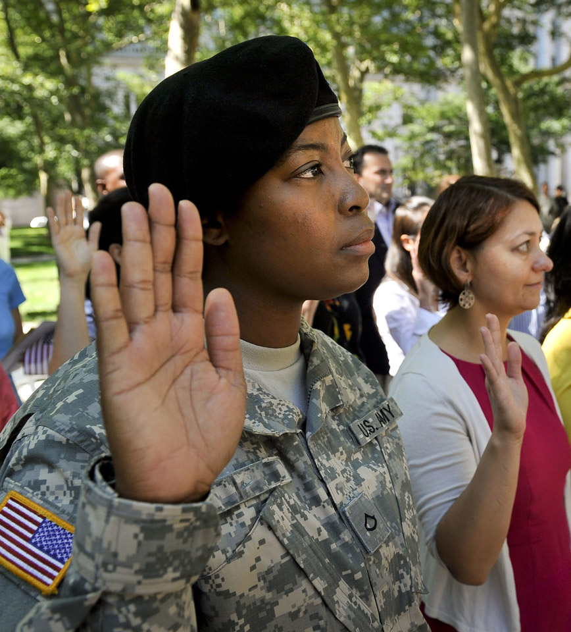
Members of the U.S. Armed Forces
Members of U.S. Armed Forces are not charged a fee for citizenship applications.
Continuous residence and/or physical presence requirements may be waived.
The brochure Naturalization Information for Military Personnel, Form M-599 has more information.
Speak to the Personnel Services/Family Connections office on base for assistance.
Notes:
35
Military applicants must process their applications through their base point of contact (POC). The final fee rule effective November 23, 2010, eliminates two citizenship-related fees for those service members and veterans of the U.S. armed forces who are eligible to file an Application for Naturalization (Form N-400) with no fee: Request for Hearing on a Decision in Naturalization Proceedings (Form N-336); and Application for Certificate of Citizenship (Form N-600).

Slide 36

The Interview
Applicants are placed under oath.
A USCIS Officer reviews Form N-400 to determine if applicant is eligible.
The naturalization test is given. Applicants have two chances to pass any part of the test.
If more information is needed to establish eligibility, the case is continued and a letter is sent to the applicant.
Notes:
The interview serves as the English speaking test.
An applicant must be able to talk with the USCIS Officer about his or her application to pass the speaking test.
If an applicant fails either the English or civics test, he or she will have a second opportunity to pass the test within 90 days.
Civics test is an oral test
100 study questions
10 questions are asked (applicant must answer 6 correctly to pass)
Applicants have three chances in the reading and writing tests

Slide 37
The Naturalization Test
Civics/History Test
Spoken English
Reading Test
Writing Test
* An applicant will be rescheduled after 60 days, if he/she is unable to pass the test at the first interview
Notes:
37
The next few slides are about the naturalization test.

Slide 38

Civics/History Test
Civics test is an oral test
100 questions are publicly available at www.uscis.gov
Applicants must answer 6 out of 10 questions correctly to pass
Notes:
38
At your interview you will be asked ten questions. The ten questions are pre-populated on a government form and not selected by the officer. All tests are the same level of difficulty.
ONLY ADDRESS IF QUESTION ARISES:
Due consideration: Allows adjudicators to apply their judgment in selecting questions from the civics exam of the appropriate difficulty for that applicant. Due consideration shall be given to the applicant's education, background, age, length of residence in the United States, opportunities available, and efforts made to acquire the requisite knowledge, and any other elements or factors relevant to an appraisal of the adequacy of the applicant's knowledge and understanding. [8 CFR 312.2 (c)(2)]

Slide 39
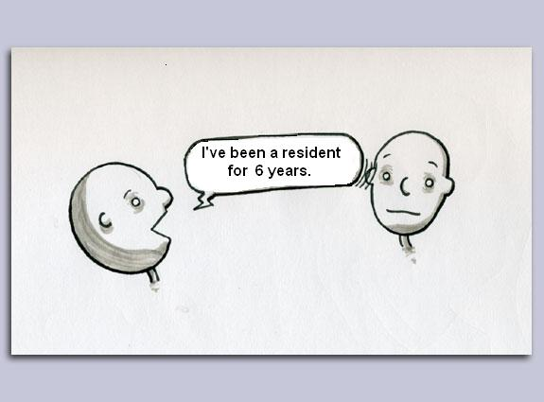
The English Speaking Test
Spoken English is assessed during the N-400 interview
USCIS Officers will repeat and rephrase questions until they are satisfied that applicant fully understands the question or does not understand English.
Notes:
39
The Part 10 questions are very detailed questions about a person’s background and allegiance to the U.S.
Applicants should review these questions with a family member, or friend or instructor to ensure they understand these questions before their interview
USCIS Officers will repeat and rephrase questions until the officer is satisfied that the applicant either fully understands the question or does not understand English
Applicants should not feel afraid or hesitate to ask an officer to repeat or rephrase a question they do not understand
If the applicant can respond meaningfully to questions relevant to the determination of eligibility, the applicant has demonstrated the ability to speak English.

Slide 40

The English Reading Test
All reading items are in the form of a question
Applicant does not need to know the answer. They just need to read the sentence.
Reading items are constructed exclusively from the vocabulary list.
Notes:
40
The applicant will have the chance to read 3 different sentences.
Once the applicant reads one sentence correctly, he/she has passed the English reading test.
Pass:
Reads one sentence without extended pauses
Reads all content words but may omit short words that do not interfere with the meaning
May make pronunciation or intonation errors that do not interfere with the meaning
Fail:
Does not read the sentence
Omits a content word or substitutes another word for a content word
Pauses for extended periods of time while reading the sentence
Makes pronunciation or intonation errors that interfere with the meaning.

Slide 41

The English Writing Test
All writing items are the answers to the reading items
Applicant does not need to know the question. They just need to write the sentence.
Writing items are constructed exclusively from the vocabulary list.
Notes:
41
The applicant will have the chance to write 3 different sentences.
Once the applicant writes one sentence correct, he/she has passed the English writing test.
The sentence does not have to be absolutely perfect. An applicant will not be failed because of spelling, capitalization, or punctuation errors unless the errors prevent understanding the meaning of the sentence.
Pass:
Has same general meaning as dictated sentence
Some grammatical/spelling errors that don’t interfere w/ meaning
May omit short words that do not interfere with meaning
Fail:
Writes nothing or only one or two isolated words
Is completely illegible
Writes a different sentence/words
Written sentence does not communicate the meaning of the dictated sentence

Slide 42

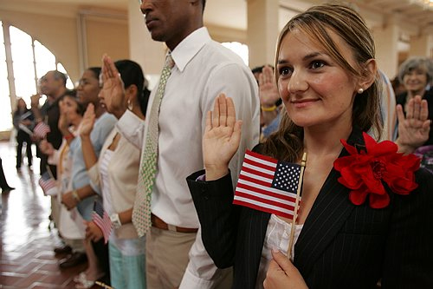
Naturalization Oath Ceremony
Oath of Allegiance
If N-400 is approved, applicant is scheduled for oath ceremony
After taking Oath of Allegiance, applicant becomes a U.S. citizen
Certificate of Naturalization is issued as proof of citizenship
Notes:
Dual Citizenship. In order to lose US citizenship, it would have to be determined that they’d committed an “expatriating act”. An Expatriating act would be something like being elected to an political office in a foreign country or fighting in another country’s armed forces. Each country is different as to whether they view taking the US oath of allegiance is “renunciatory” of that country’s citizenship. People should address those questions to their embassies.

Slide 43

Rights of U.S. Citizens
Right to Vote
Freedom of Speech & Expression
Freedom of Religion
Right to Trial by Jury
Life, Liberty & Pursuit of Happiness

Slide 44

Responsibilities of U.S. Citizens
Vote
Respect & Obey Laws
Pay Taxes
Serve on Jury
Notes:
Any others? Participate in your community? Volunteer?

Slide 45
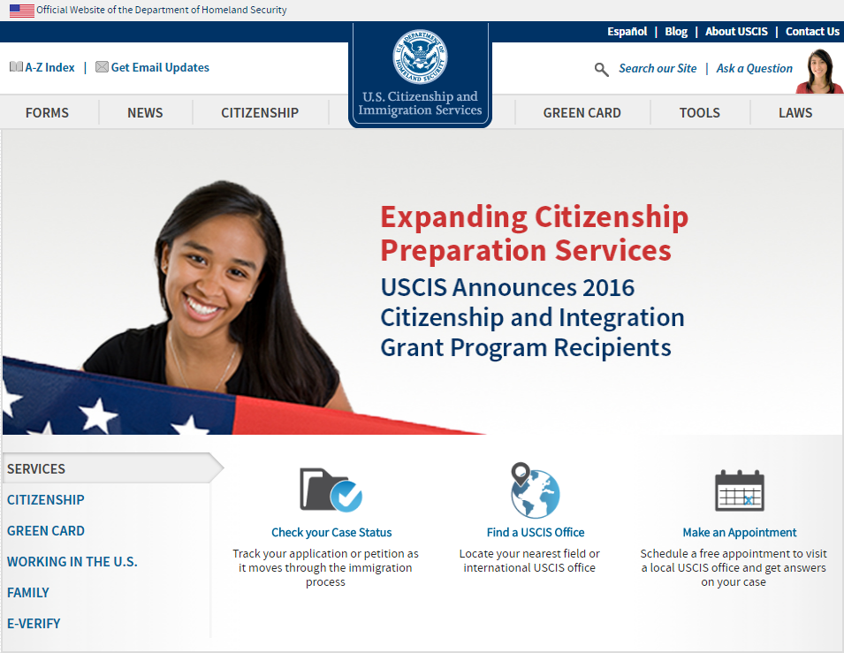
www.uscis.gov
Notes:
Case status on-line
INFOPASS
Free forms
www.uscis.gov in Spanish
Call 1-800-375-5283 for free help!

Slide 46
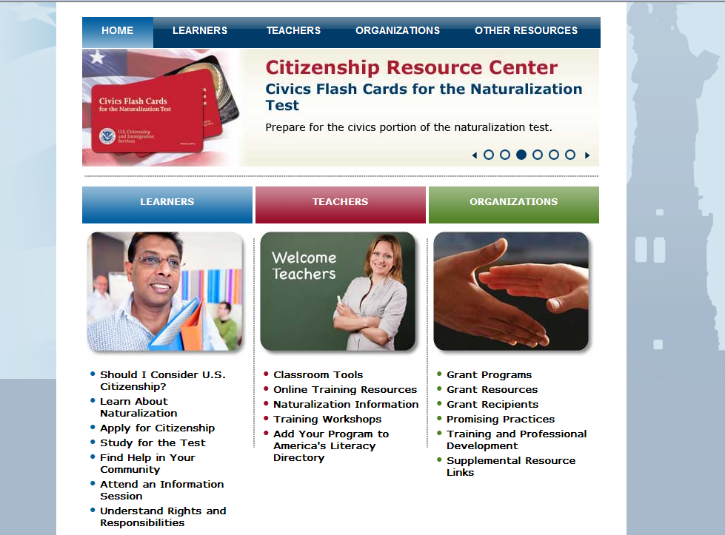
www.uscis.gov/citizenship
www.uscis.gov/citizenship

Slide 47
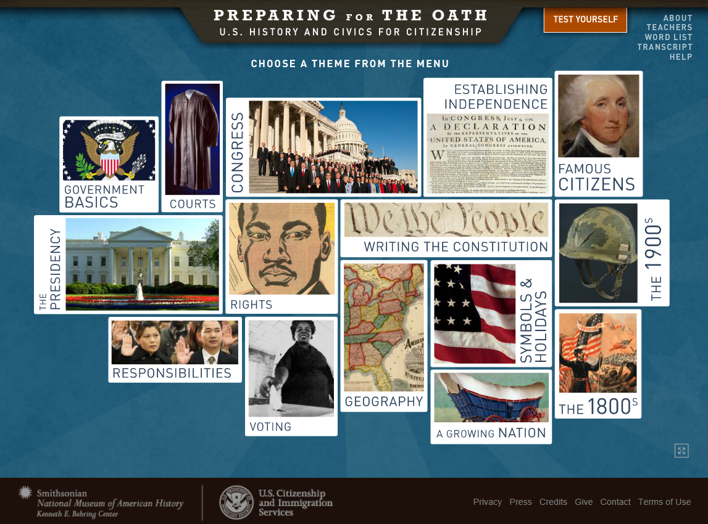
americanhistory.si.edu/citizenship
Notes:
Case status on-line
INFOPASS
Free forms
www.uscis.gov in Spanish
Call 1-800-375-5283 for free help!

Slide 48

Questions?
Notes:
I hope this very general overview will provoke some good questions and I’ll look forward to hearing from you. I know immigration is a controversial topic so I’d love to hear any questions you may have.

