Slide 1
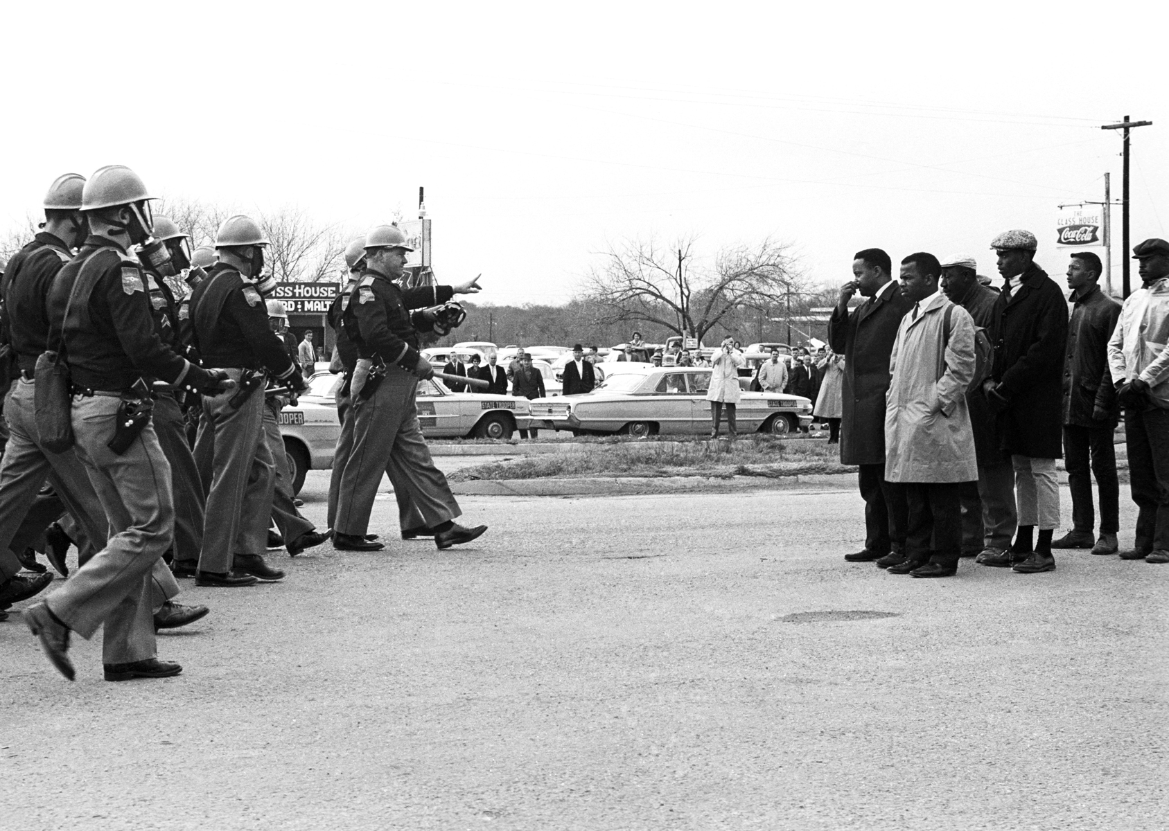
Selma, 1965 and the Right to Vote

Slide 2
Attorney General Herbert Brownell

Slide 3
Lyndon B. Johnson Senate Majority Leader

Slide 4
Brownell fights off Hoover and Ike

Slide 5
Johnson has to convince Richard Russell to cut him some slack

Slide 8
Findings of the Civil Rights Commission
Dallas County – whites eligible 14,400
whites registered 9,195
non-white eligible 15,115
non-white registered 130
Lowndes County – whites eligible 1,900
whites registered 2,240
non-white eligible 5,122
non-white registered 0

Slide 9
John Doar US Department of Justice, Civil Rights Division

Slide 10
John Doar as lead counsel for the impeachment of President Nixon – do you recognize the women by his left shoulder?

Slide 11
Images that led to the Civil Rights Act of 1964 – Freedom Riders

Slide 13
Dogs

Slide 14
Fire hoses

Slide 15
Sit-Ins

Slide 16
Amelia Boynton – Selma activist

Slide 17
Bernard LaFayette the first “outside agitator” from SNCC “snick”

Slide 18
Nonviolence can be dangerous work

Slide 19
Father Ouellet an important ally

Slide 20
First mass meeting for voting rights

Slide 21
Sunday, September 15, 1963

Slide 24
Rev. Jim Bevel and Diane Nash (SCLC)

Slide 25
Nashville Roots for the Movement

Slide 26
Freedom Day, October 1963

Slide 27
The First Amendment need not apply

Slide 28
Sheriff Jim Clark

Slide 29
John Lewis – another Freedom Rider causing trouble in Selma

Slide 30
Freedom Day, July 1964 – Same result, plus an injunction

Slide 31
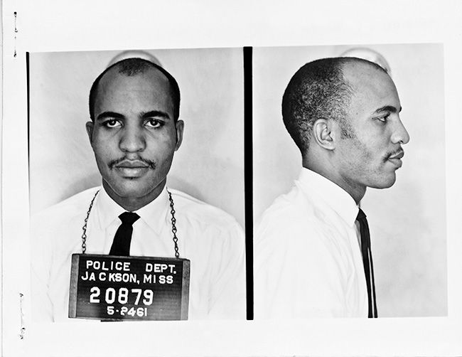
December 1964 Boynton and Bevel push for Selma

Slide 32
Changes: a new mayor and new police chief

Slide 33
But the old sheriff

Slide 34
Give us the ballot

Slide 36
Science teacher Fred Reese

Slide 37
Rev. C.T. Vivian

Slide 40
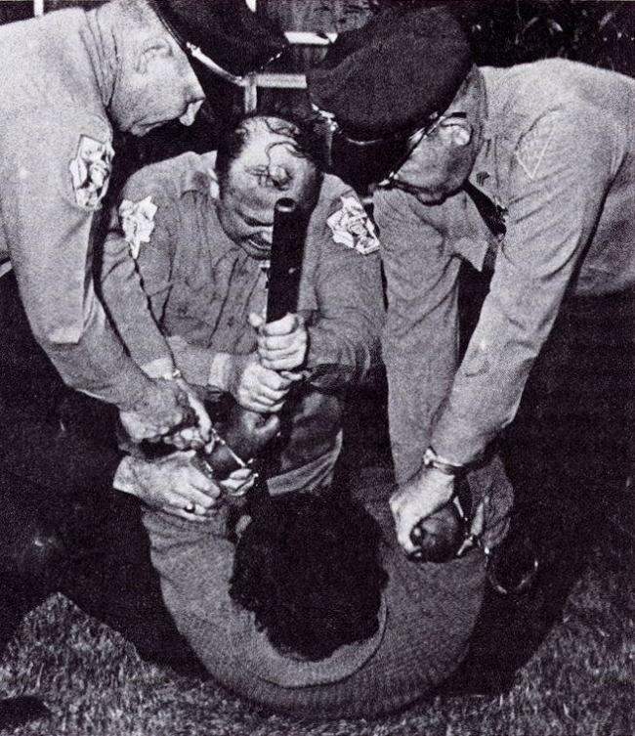
Annie Lee Cooper fights back

Slide 41
Students step up

Slide 42
Get Ready to Run

Slide 43
Strategizing

Slide 44
Time for a second front: Marion

Slide 45
James Orange – the big guy in the back

Slide 46
Jimmie Lee Jackson

Slide 48
“She should go in unto the king and make supplication unto him, and to make request before him for her people.” – Esther 4:8

Slide 49
Segregation Forever

Slide 50
People Get Ready

Slide 52
Go back to your church

Slide 60
Waiting to pounce

Slide 65
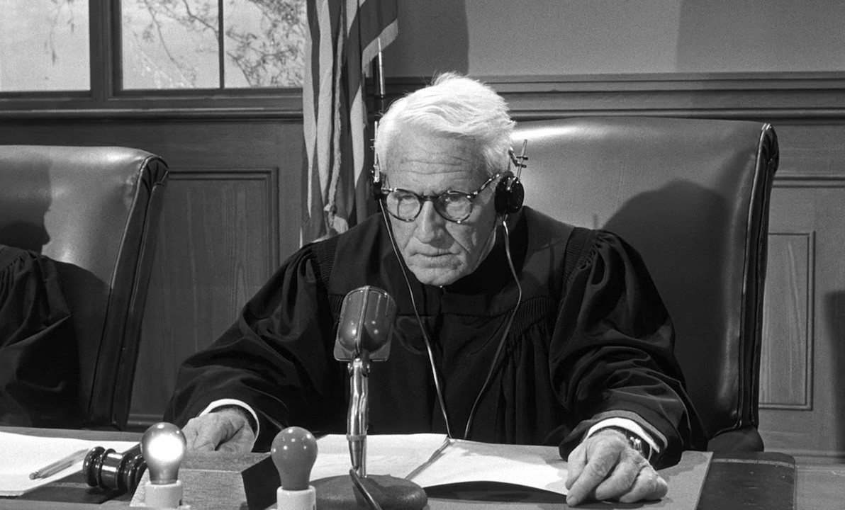
We interrupt this program…

Slide 66
The country pays attention

Slide 67
Come to Selma and march with us

Slide 68
Attorney Fred Gray

Slide 69
United States District Judge Frank Johnson

Slide 70
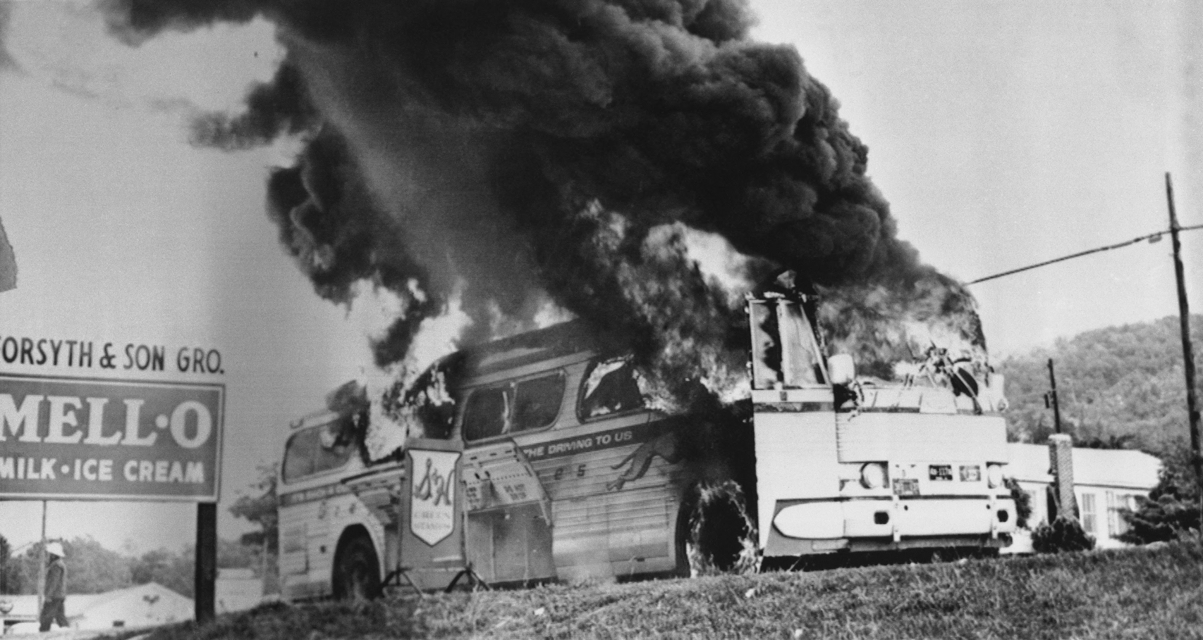

Slide 71
Let’s Make a Deal

Slide 72
Turnaround Tuesday

Slide 73
Rev. James Reeb

Slide 76
The “Berlin” Wall

Slide 78
We Shall Overcome

Slide 80
Attorney General Katzenbach

Slide 81
The Third March

Slide 83
Impact of Vatican II

Slide 86
Feeling threatened

Slide 91
The last leg

Slide 92
Entering Montgomery

Slide 96
How long, not long

Slide 97
Viola Liuzzo

Slide 104
Colin Wilkie

